Slide 2
Websites, Webpages, and Web Servers
Websites
  Number of pages varies depending on site’s purpose and type of content and services it provides
  Home page is the primary webpage at a website
  A web portal, or simply a portal, is a special type of website that offers access to a vast range of content and services

Slide 3
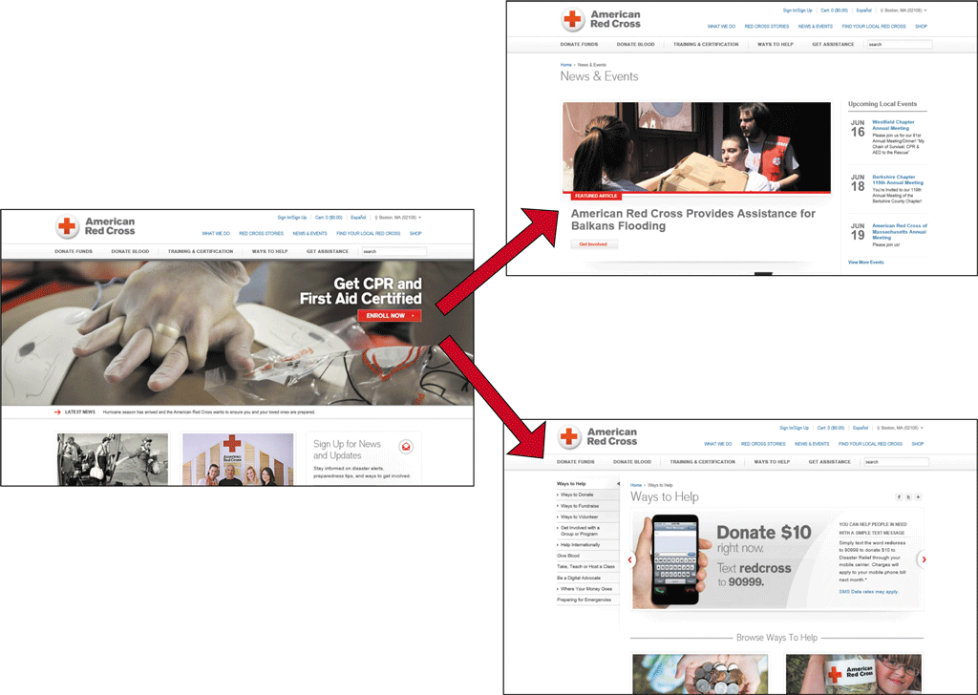
Websites, Webpages, and Web Servers

Slide 4
Websites, Webpages, and Web Servers
Webpages
  Designed to attract visitors and hold their attention
  Common characteristics
    Logo and/or name
    Images and media
    Links
    Advertisements
    Search tool
    Connectivity links or icons
    Copyright statement
    Link to a privacy and security policy statement

Slide 5
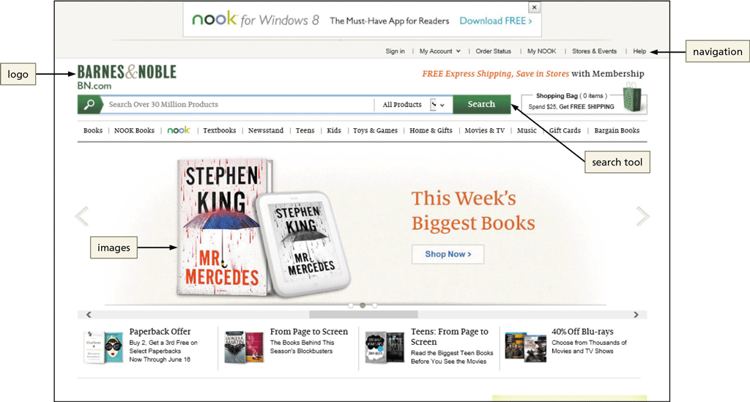
Websites, Webpages, and Web Servers

Slide 6
Websites, Webpages, and Web Servers
Web Servers
  Browser is a client that requests services from a web server
  Server “serves up” or provides the requested resources or services
    Web browsing is example of client/server computing

Slide 7
Websites, Webpages, and Web Servers
Web Servers (continued)
  Single web server can host multiple websites
  Larger websites may be stored across multiple web servers

Slide 8
Domain Names, IP Addresses, and URLs
IP Address
  A unique number that identifies each computer or device connected to the Internet
  Static IP addresses seldom change
  Dynamic IP addresses are temporary
  2 Versions
    IPv4: 4 numbers (0-255) separated by a dot.
      Example: 69.32.133.11
    IPv6: 8 hexadecimal numbers (0- 65,535) separated by a colon
      Example: 3ffe:1900:4545:3:200:f8ff:fe21:67cf
مؤقت

Slide 9
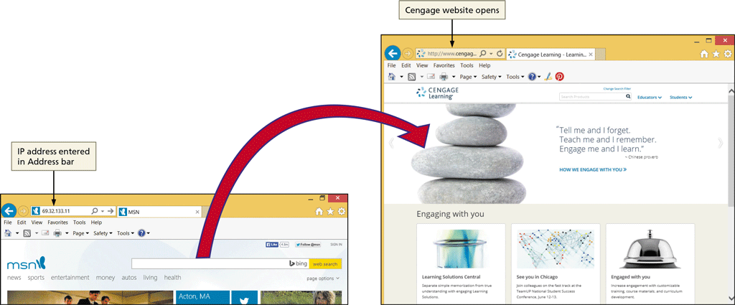
Domain Names, IP Addresses, and URLs

Slide 10
Domain Names, IP Addresses, and URLs
Domain Names
  A text alias for one or more IP addresses
    google.com is domain name for 172.217.19.142 Domain Name System (DNS) uses name servers to translate domain name to numeric IP address
    Managed by ICANN (The Internet Corporation for Assigned Names and Numbers)
    TLD (top-level domain )(.com, .edu, .gov, .biz,….)
    ccTLD (Country Code)(.us, .uk, .ca,…)

Slide 11
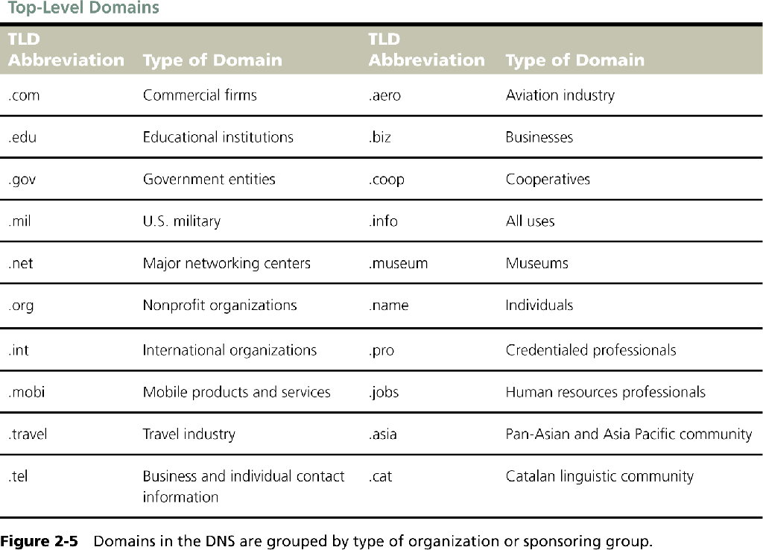
Domain Names, IP Addresses, and URLs

Slide 12
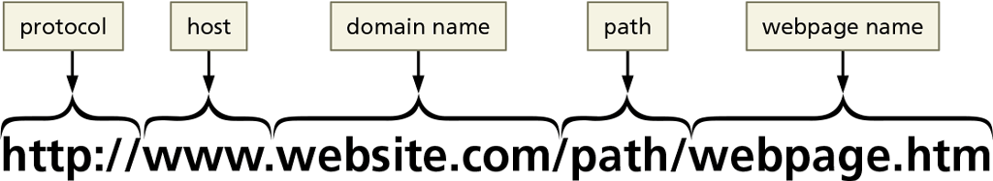
Domain Names, IP Addresses, and URLs
Uniform Resource Locators (URLs)
  A unique web address
    http:// (Hypertext Transfer Protocol) is the set of rules for transferring files such as text, images, sound, video and other multimedia files -- over the web
    host
    Domain name, Path, Webpage name

Slide 13
Connecting to the Internet
Check to be sure you are connected
  Smartphone – check for connection
  Mobile device – access Settings menu or folder to enable Wi-Fi
  Laptop or desktop – go to settings or Control Panel to enable Wi-Fi

Slide 14
Browsers
Software or app used to access and view webpages
Popular browsers for personal computers in homes and businesses
  Google Chrome
  Mozilla Firefox
  Microsoft Windows Internet Explorer
  Apple Safari
  Opera

Slide 15
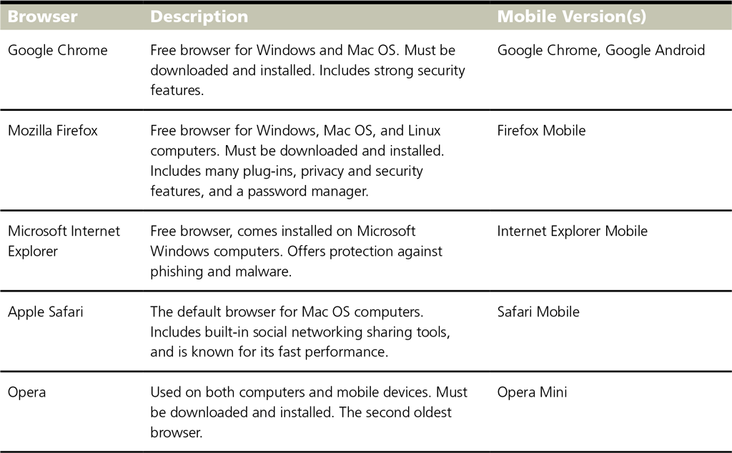
Browsers

Slide 16
Browsers
Internet Explorer 11 features
  Home page
  Display area
  Back and Forward buttons
  Address bar
  Home button
  ‘View favorites, and history’ button
  Tools button
  Tabs for each open webpage

Slide 17
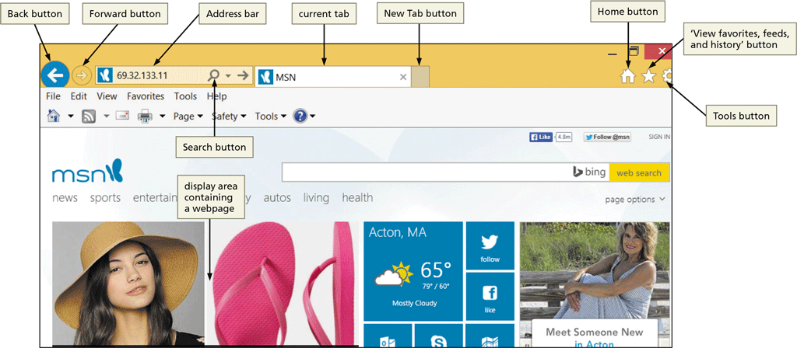
Browsers

Slide 18
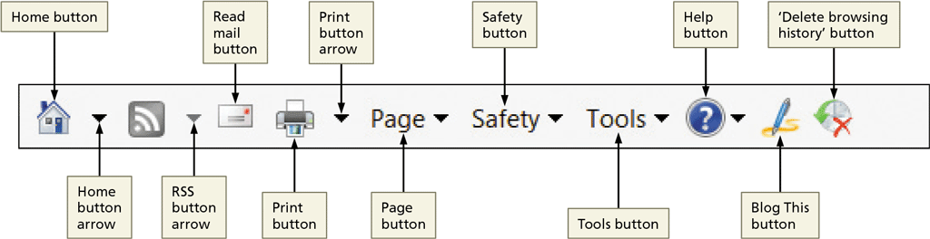
Browsers
Internet Explorer 11 features (continued)
  New tab button
  Scroll bar
  Command bar – optional, customizable toolbar

Slide 19
Opening Your Browser and Loading a Webpage
Double-click the browser icon on the desktop, click the browser icon on the taskbar, or tap the browser icon on the home screen of your mobile device
Tap or click the Address box on the Address bar
Enter www.cengage.com as the URL
Press the ENTER key or tap or click the appropriate browser button to open the Cengage home page

Slide 20
Opening Your Browser and Loading
a Webpage

Slide 21
Using a Search Box to Find Information
Enter Discovering the Internet in the Search Products text box
Press the ENTER key or tap or click the appropriate button to begin the search
Tap or click the link for this text to open the webpage

Slide 22
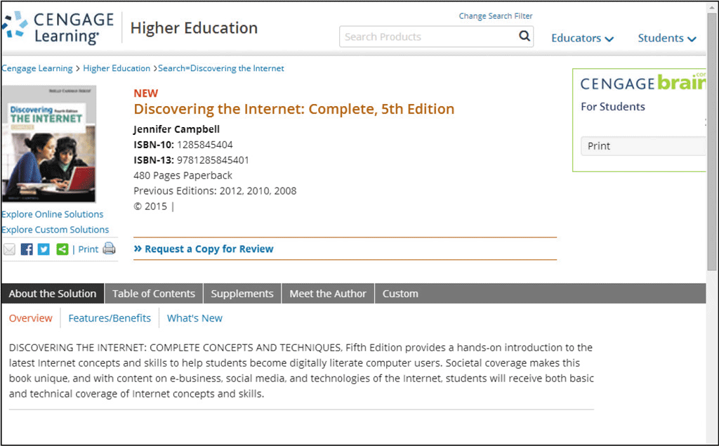
Using a Search Box to Find Information

Slide 23
Viewing a Webpage
Tap or click the Cengage Learning logo to return to the home page or enter cengage.com in the Address bar, and then tap or click the appropriate button
Drag the scroll box on the vertical scroll bar down, or swipe your finger upward if using a touch screen, to view the content at the bottom of the webpage, and then drag or swipe downward to view the top of the webpage

Slide 24
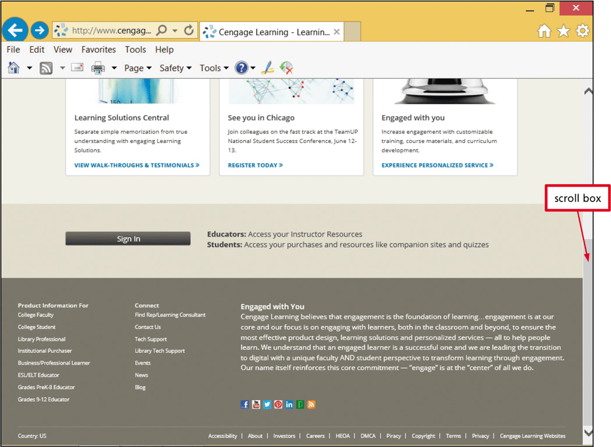
Viewing a Webpage

Slide 25
Browsers
Navigating Recently Viewed Webpages
  Use the Back, Forward, Stop, Refresh, and Home Buttons
    Back and Forward buttons – revisit recently viewed webpages
    Stop and Refresh buttons – stops opening a page or opens an updated copy of the current page
    Home – displays the home page(s)

Slide 26
Navigating Through Recently Viewed Pages
Type weather.com in the Address box
Press the ENTER key or tap or click the necessary button to open the weather.com webpage
Tap or click any link to open a new webpage
Click the Back button to return to The Weather Channel home page
Tap or click the Forward button, if available, to return to the webpage you were viewing before you clicked the Back button

Slide 27
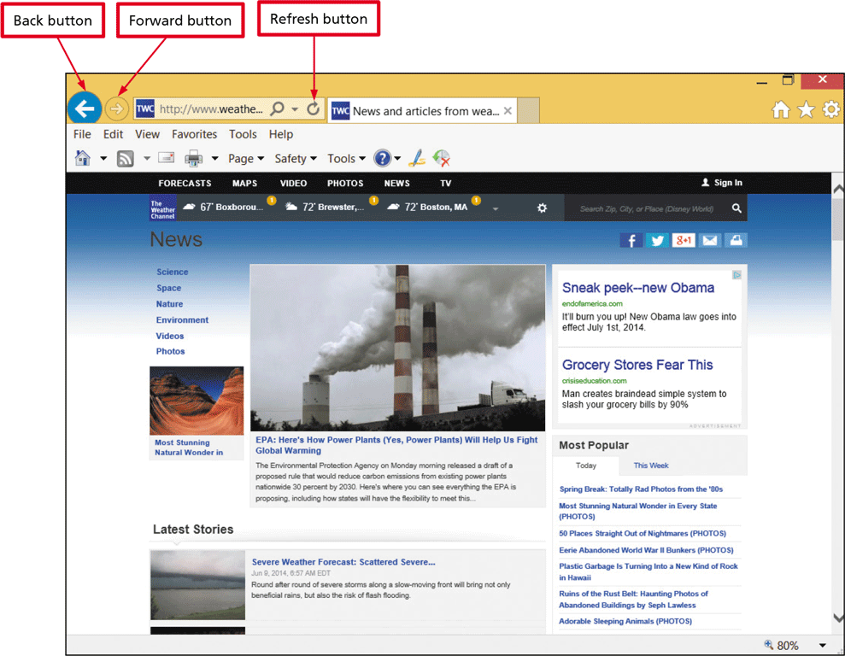
Navigating Through Recently Viewed Pages
Tap or click the Refresh button or menu command, or swipe at the top of the mobile browser window to access the refreshed webpage

Slide 28
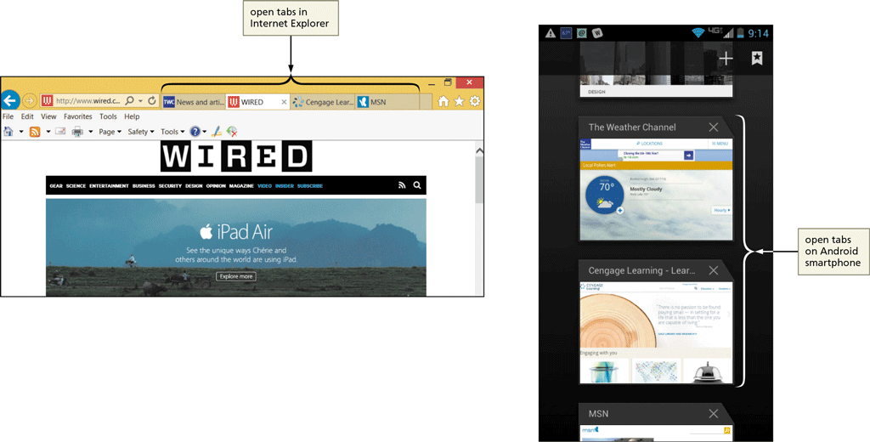
Browsers
Using Tabbed Browsing
  Allows you to open multiple webpages in a single browser window

Slide 29
Browsers
Using Tabbed Browsing (continued)
  Each page can be opened in its own tab
  On mobile devices, view open tabs using a menu command
  New tab button displays a blank tab on which you can enter a URL
  Tapping or clicking a tab brings the webpage and tab from the background to the foreground
  Click the New Tab button to open a blank tab then enter URL in the Address box to open a webpage in the new tab

Slide 30
Opening and Closing Multiple Webpage Tabs
Tap or click the Internet Explorer to open Internet Explorer
Tap or click the New Tab button on the tab row to open a new tab page
Type espn.com in the Address bar
Press the ENTER key or tap or click the appropriate button to open the home page in the new tab

Slide 31
Opening and Closing Multiple Webpage Tabs
Tap or click the New tab button on the tab row to open a new tab
Enter nfl.com in the Address box
Tap or click the necessary button to open the NFL.com home page
Tap or click the Close Tab button on the NFL News webpage tab to close the webpage
Tap or click the New tab button on the tab row to open a new tab
Tap or click the ‘Reopen closed tabs’ button on the New tab page, if available, to see a list of closed tabs

Slide 32
Opening and Closing Multiple Webpage Tabs
Tap or click the NFL News link to reopen the webpage in a new tab
Close the browser and close all tabs, if asked
Start the browser
Tap or click the New tab button on the tab row to open a new tab page if necessary
Tap or click the ‘Reopen last session’ button if available to reopen the tabs that were open when you closed the browser

Slide 33
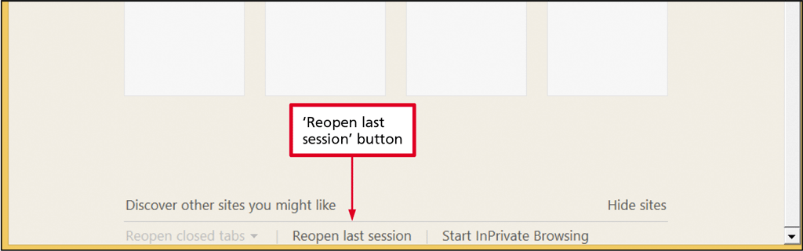
Opening and Closing Multiple Webpage Tabs

Slide 34
Switching Between Open Webpages Using a Mobile Browser
Locate the Tabs button, which likely will appear in the upper-right corner of the mobile browser window
Tap or click the Tabs button to display open tabs
Swipe up or down, or use a scroll bar if available, to view all open tabs
Tap or click a tab to display it in the foreground

Slide 35
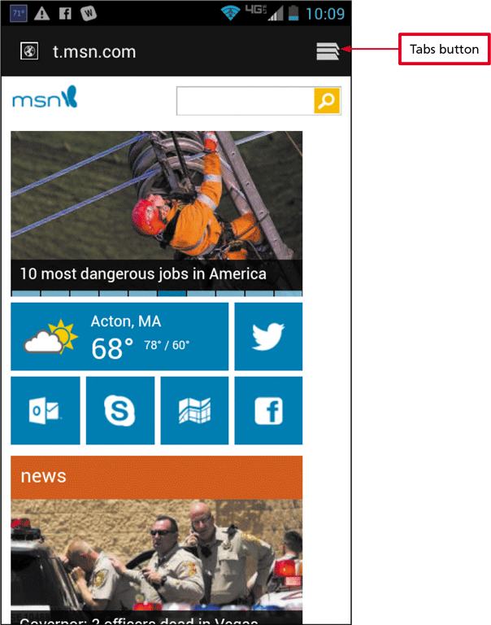
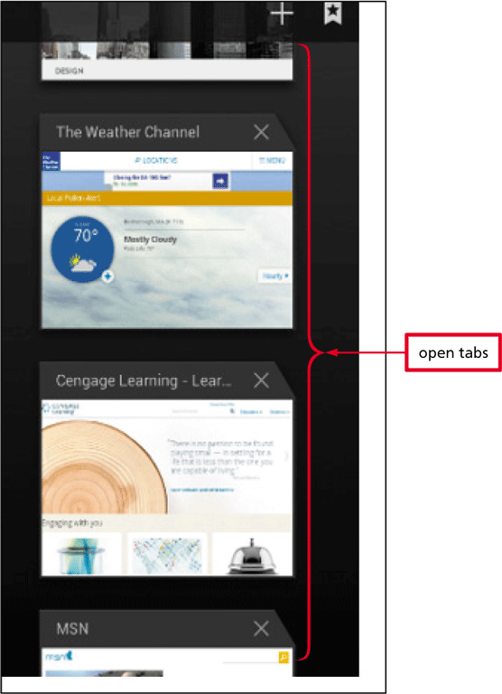
Switching Between Open Webpages Using a Mobile Browser

Slide 36
Creating a Website Shortcut on the Desktop
Navigate to www.msn.com if necessary
If necessary, minimize browser window so that you can see the desktop
Tap or click the MSN icon in the Address bar or select the URL in the Address bar
Drag the icon or suggested URL to the desktop to create a shortcut

Slide 37
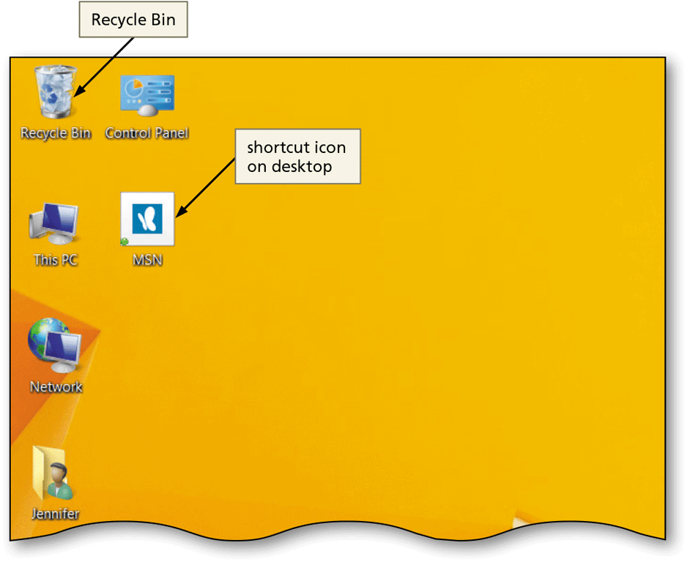
Creating a Website Shortcut on the Desktop

Slide 38
Saving Online Information
Printing a Webpage
  Preview the webpage
  Change paper size, margins, and orientation, header and footer content
  Print a printer-friendly format

Slide 39
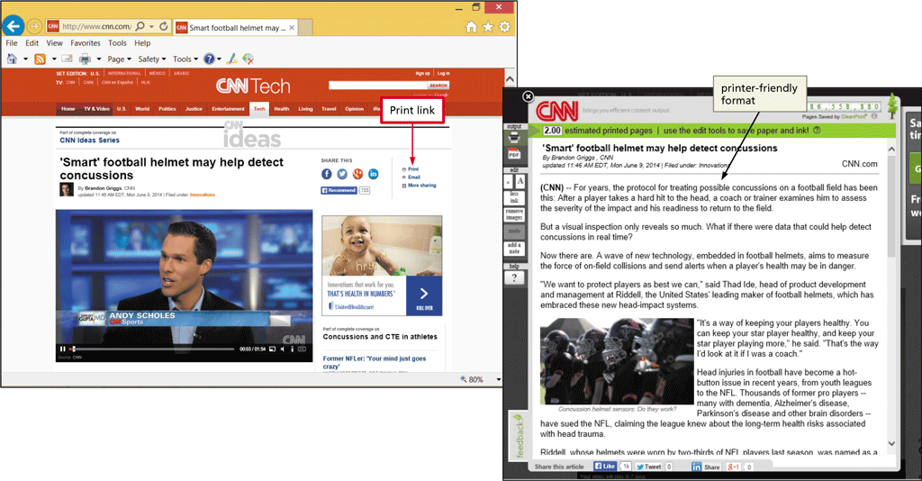
Saving Online Information

Slide 40
Saving Online Information
Saving a Webpage
  Webpage, complete (HTML files and all related files)
  Archive file of webpage
  HTML file only
  Text file
Sharing a Webpage
  ‘Send page by email command’ in browser
  Email or Text icon at website
  Share via social media and content sharing websites

Slide 41
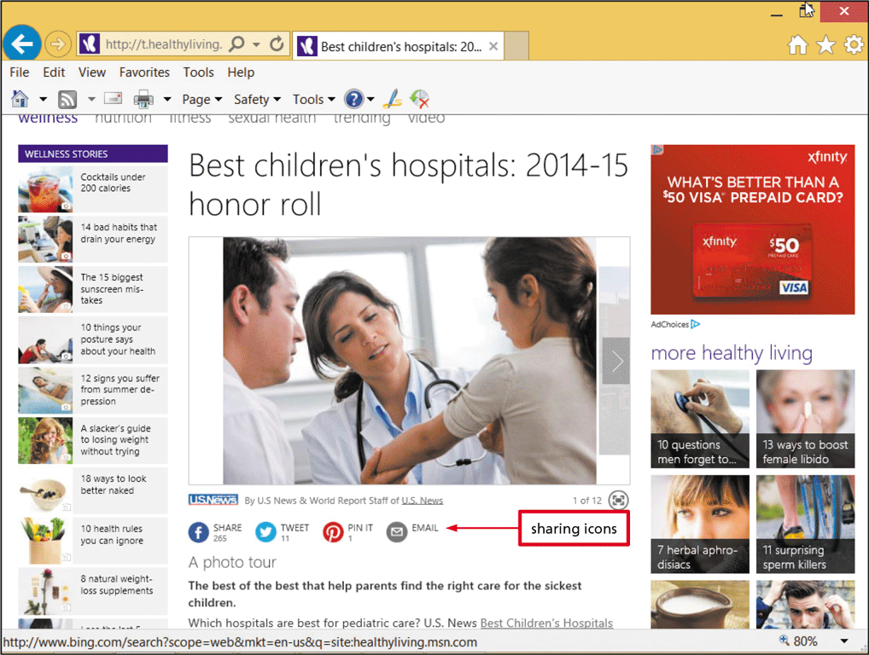
Saving Online Information

Slide 42
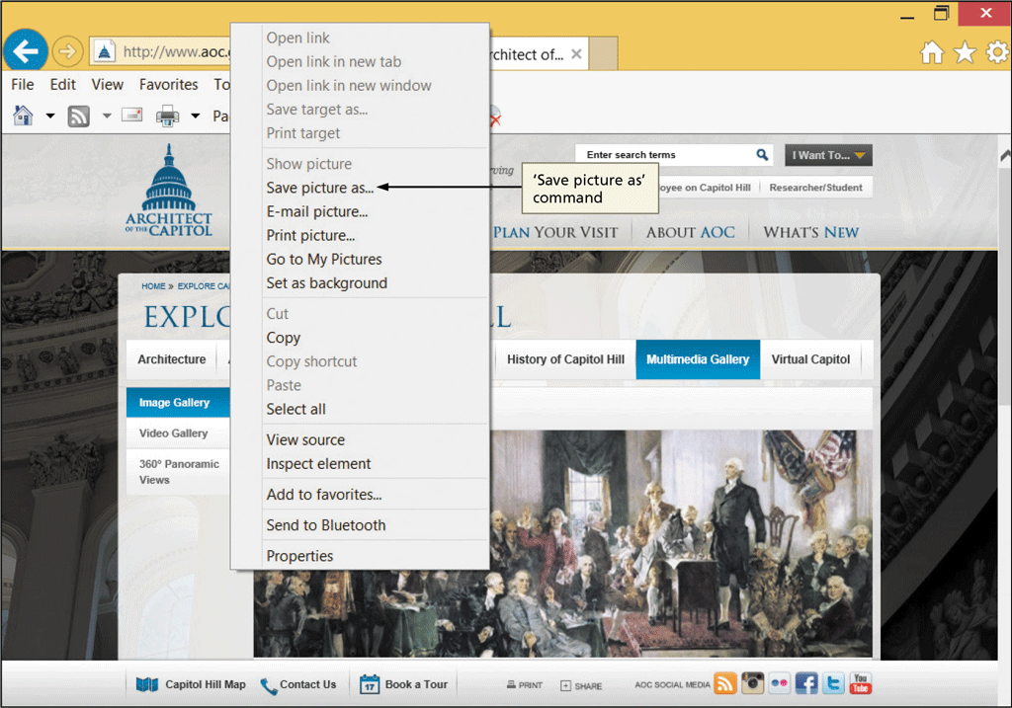
Saving Online Information
Saving a Webpage Image
  Ownership and copyright considerations
  Typically can right-click image to display menu

Slide 43
Using the Web: Risks and Safeguards
Protecting Your Computer from Hackers
  A hacker is an individual who uses his or her technology skills to access a network and the computers on that network without authorization
  A firewall is hardware and/or software that protects a computer or network from unauthorized access by hackers
    Operating system might provide a firewall
    Use password protection
    Many routers and other network devices include firewalls

Slide 44
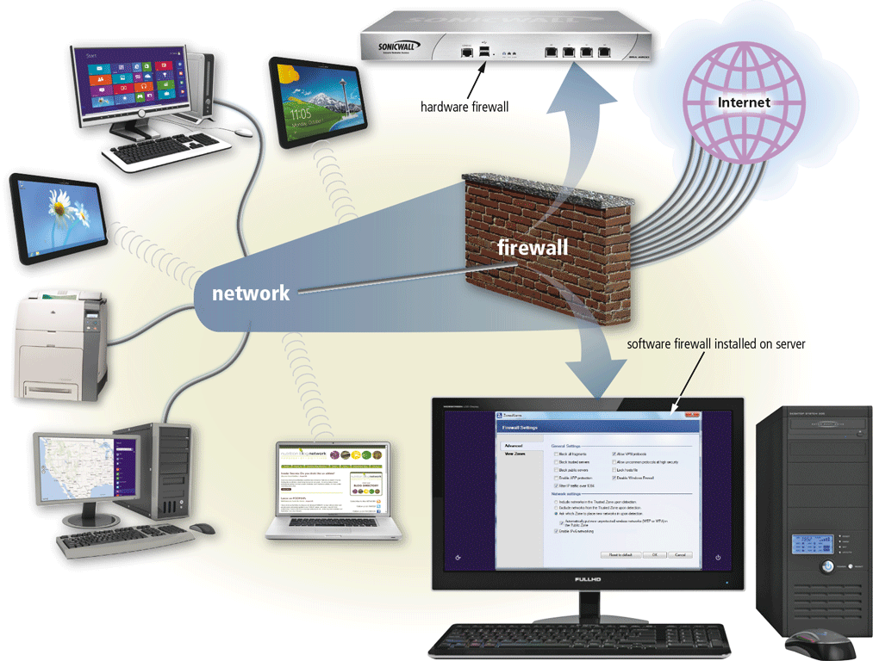
Using the Web: Risks and Safeguards

Slide 45
Using the Web: Risks and Safeguards
Virus Protection
  A virus is a small, potentially damaging computer program or app
  Most browsers include filters and virus detection
  Can be spread to other computers through:
    Sending/receiving e-mail message, text message, or file attachment
    Downloading software and apps
  Install virus protection software to protect against infection and update it automatically

Slide 46
Using the Web: Risks and Safeguards
Shopping Safely Online
  Use reputable online vendors
  Pay with a credit card over a secure connection
  Never send your credit card number or other personal information as an email or text message

Slide 47
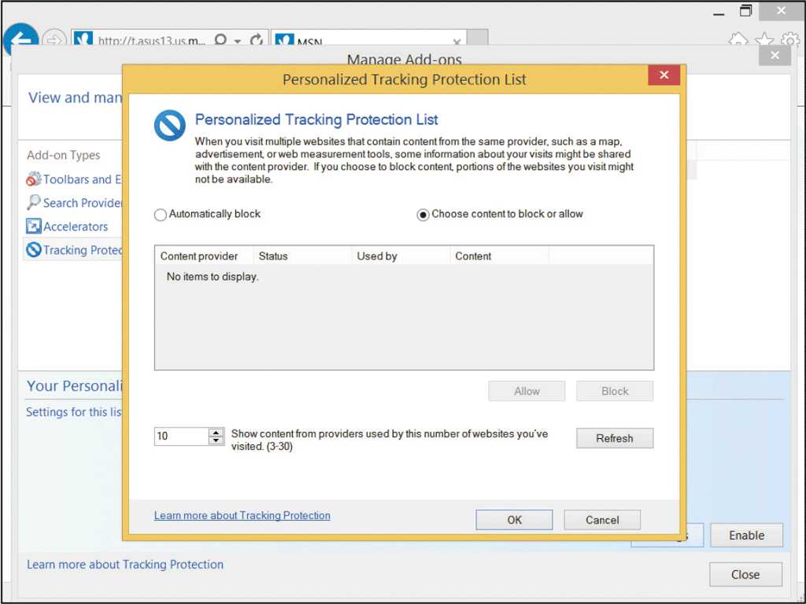
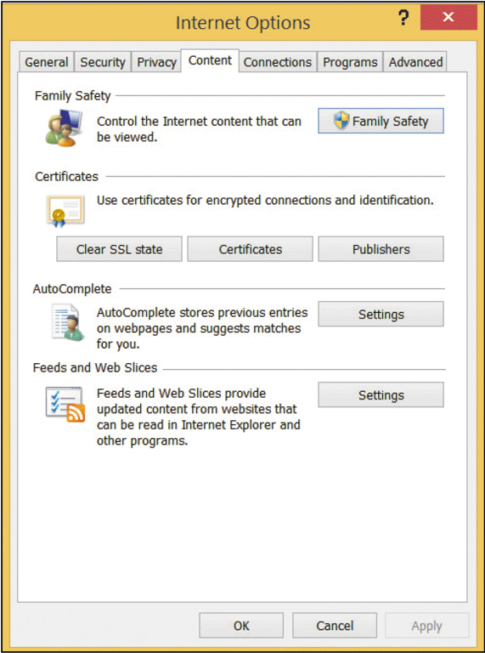
Using the Web: Risks and Safeguards

Slide 48
Using the Web: Risks and Safeguards
Protecting against Malicious Websites
  A malicious website is a website designed to look like a legitimate site, but is owned by hackers or online thieves
  Used by thieves to:
    Collect personal information, such as name and password
    Distribute malicious software
  Most browsers have built-in filters for detecting malicious websites

Slide 49
Using the Web: Risks and Safeguards
Keeping Your Personal Information Private
  Information privacy refers to the right of individuals and companies to deny or restrict the collection and use of personal information.
  Entities that might be collecting and using your private information:
    Employers
    Internet Service Providers
    Government agencies
    Privacy Advocates

Slide 50
Using the Web: Risks and Safeguards
Keeping Your Personal Information Private (continued)
    Privacy Advocates – dedicated to informing government agencies and consumers about privacy issues and maintaining information about privacy issues at their websites
    Business websites
    Cookies – Small text file stored on a computer of device
    Spyware – technology that accesses your computer system to gather information without your knowledge and approval
    Adware – form of spyware that gathers information then uses it to deliver targeted web advertising

